Slide 1


Electronic Tour Planner
ETP

Slide 2
Team Members
Mohamed Fathy Mohamed.
Gemian Talasoun Sadeq.
Mohamed Gamal Negm.
Hassaan Nabil Hassan.

Slide 3
Project advisors
Dr. Mohamed Ramadan Saady.
Dr. Amany Ashraf Salama

Slide 4


Outline
Introduction.
Motivation.
Proposed.
Application prototype.
Algorithms
Feed back
Conclusion.

Slide 5
Introduction
Tourism is one of the most important ways of increasing national income.
Some governments are using technology to improve in this industry.
ETP was created to contribute to facilitating the tourism process.

Slide 6
Motivation
Planning a customized trip, for the available time, and specific budget is usually a complex task.
This task will cost a lot of time and effort.
Tourist do not have enough information to make a suitable plan.
Tourist is forced to visit places, do not match his personality.

Slide 7
Proposed
The electronic tour planner (ETP) system generates plans for tourists who would like to visit Luxor by enable him to automatically plan the touristic trip.
ETP provides additional services such as :
Dashboard
Ekko chatbot
Places information

Slide 8
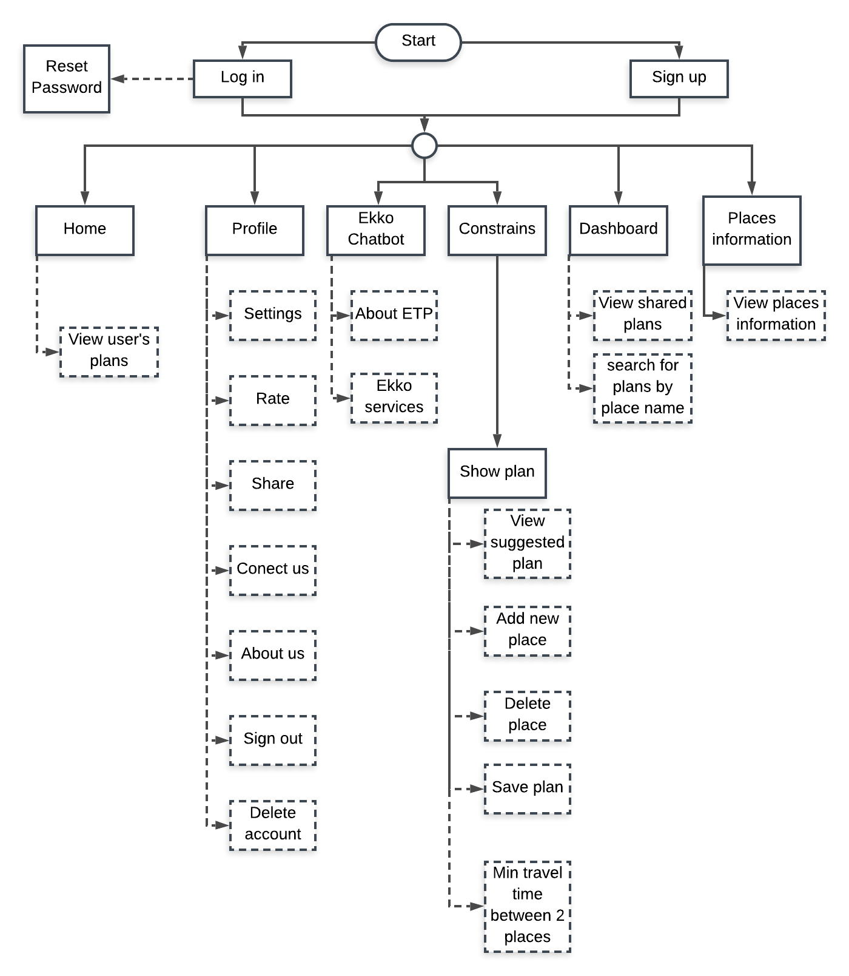
Application Prototype
ETP system contains main pages that provide several services based on their functionality, the figure describe these pages and their services.
The terminology that we used to implement ETP system:
1) Android Studio (Mobile Application)
2) Firebase (database)
3) google API (Login with google)
Next 6 slides explain how we implement ETP system.

Slide 9
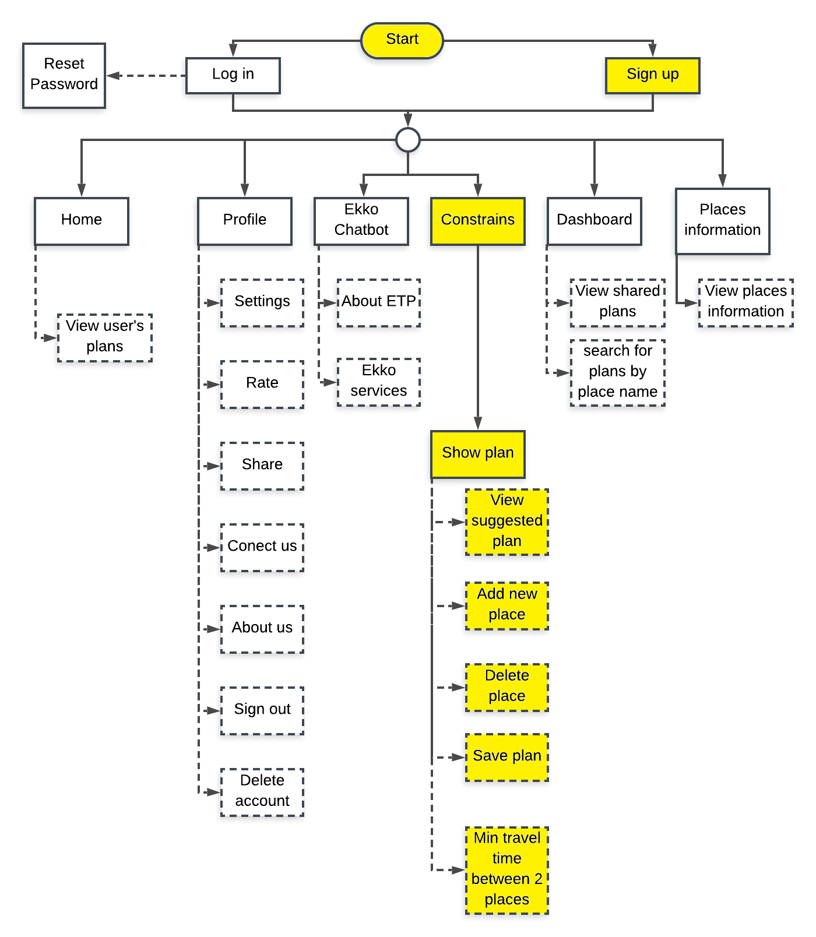
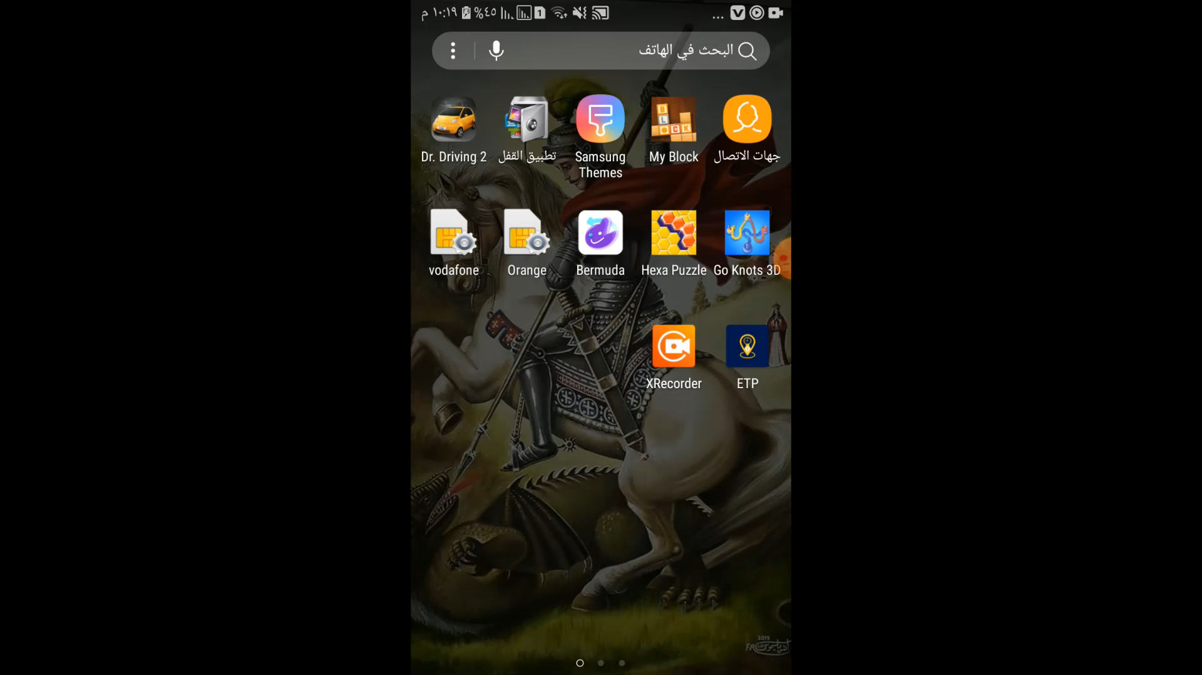
Sign Up & Add Plan

Slide 10
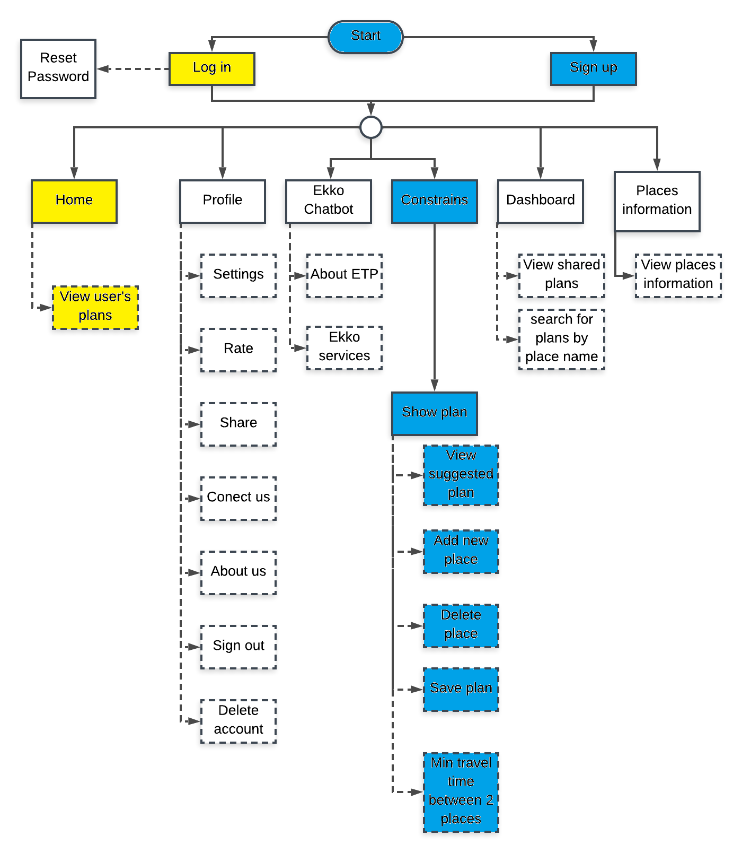
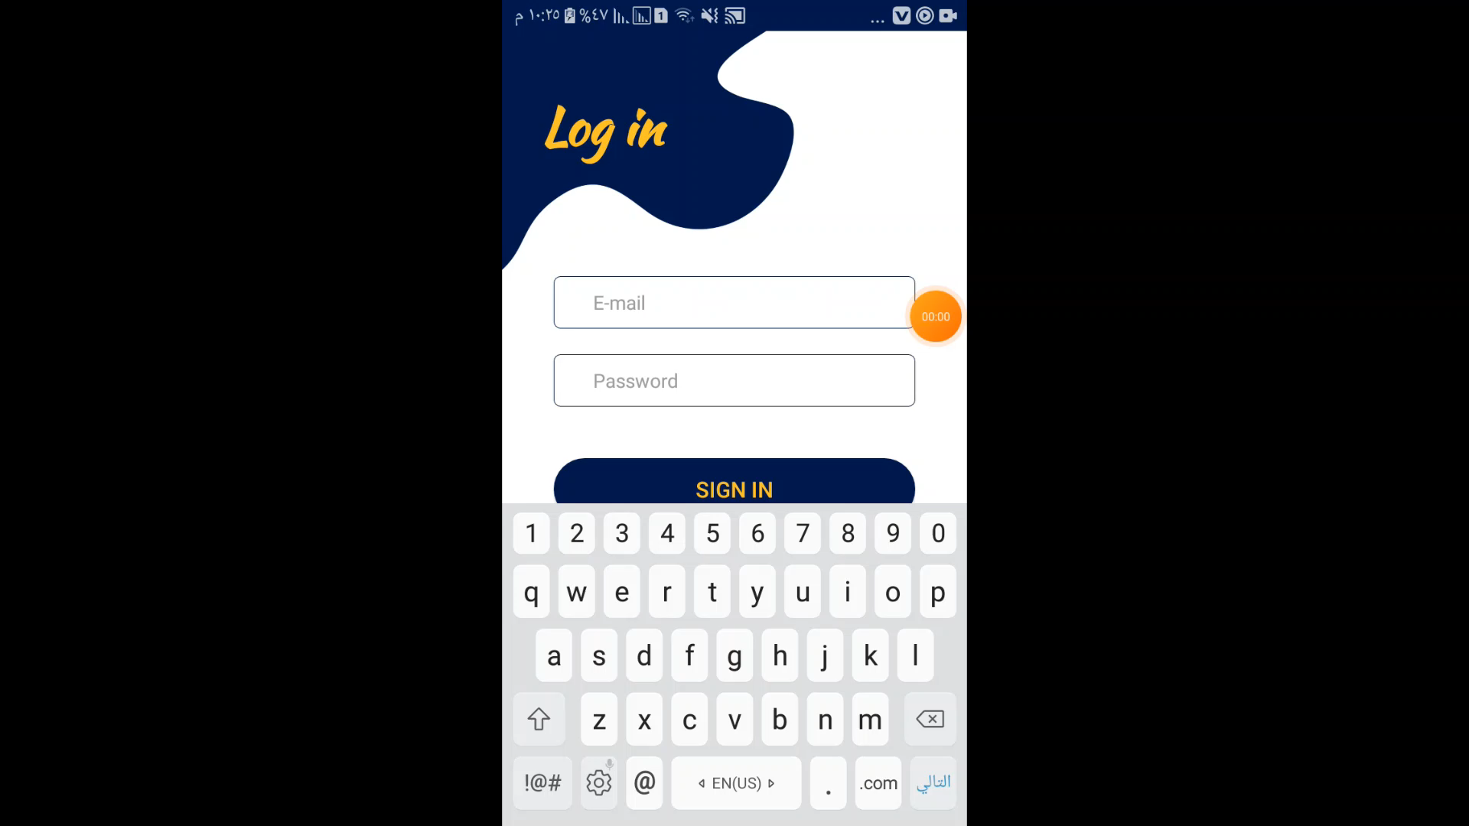
Login & Home

Slide 11
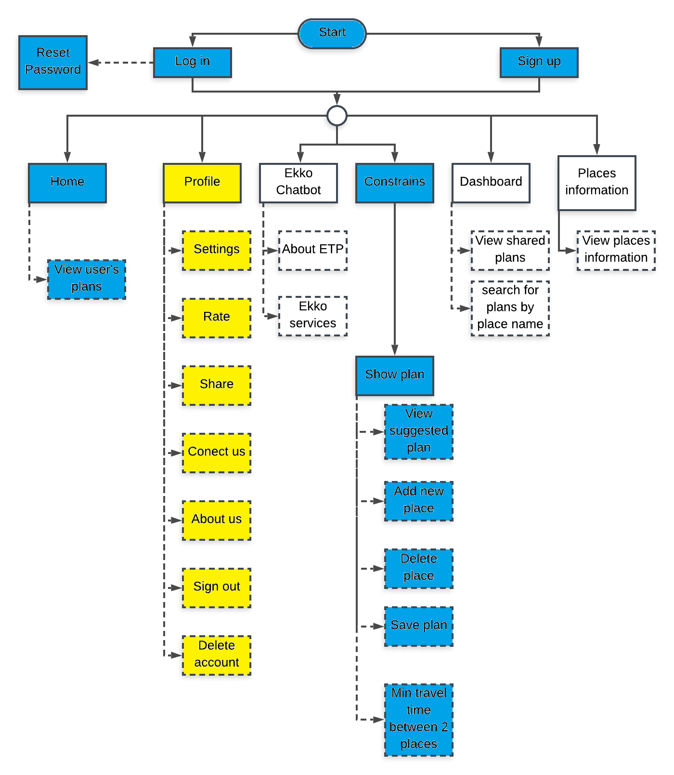
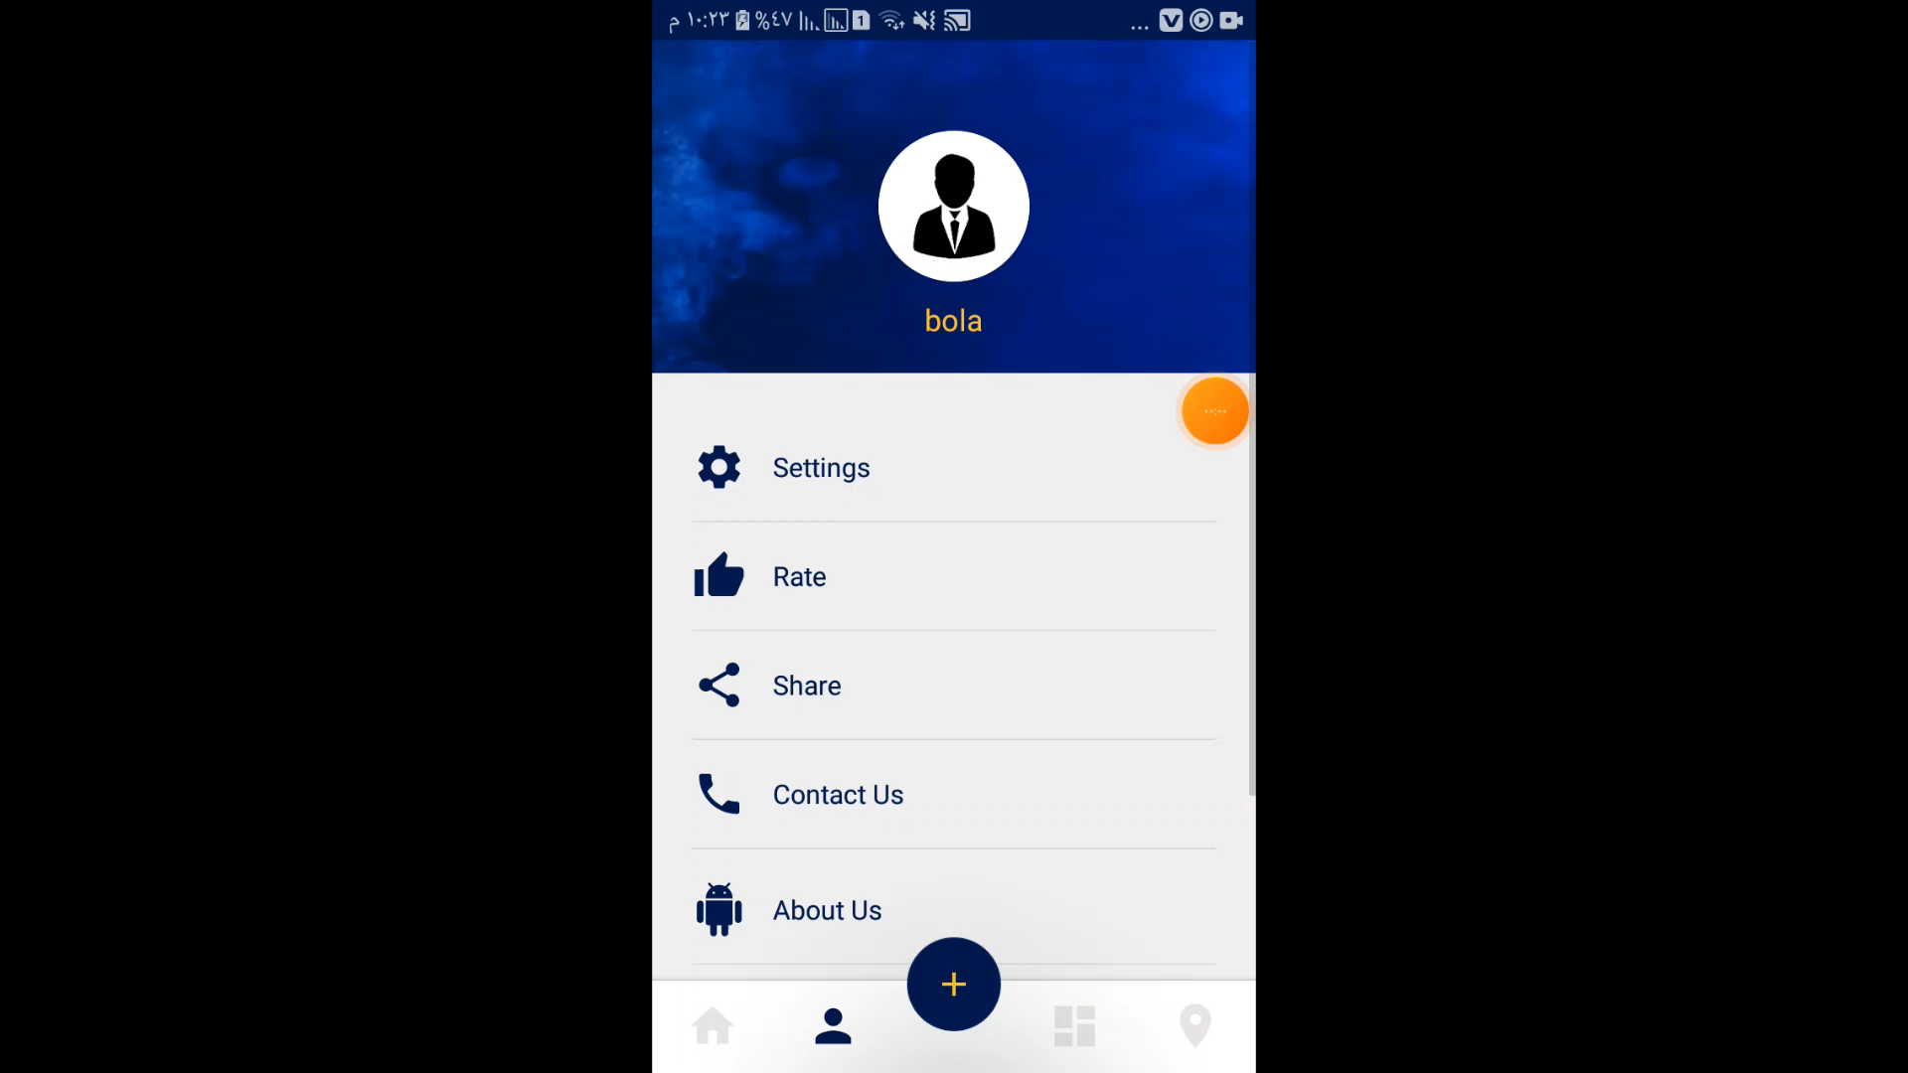
Profile

Slide 12
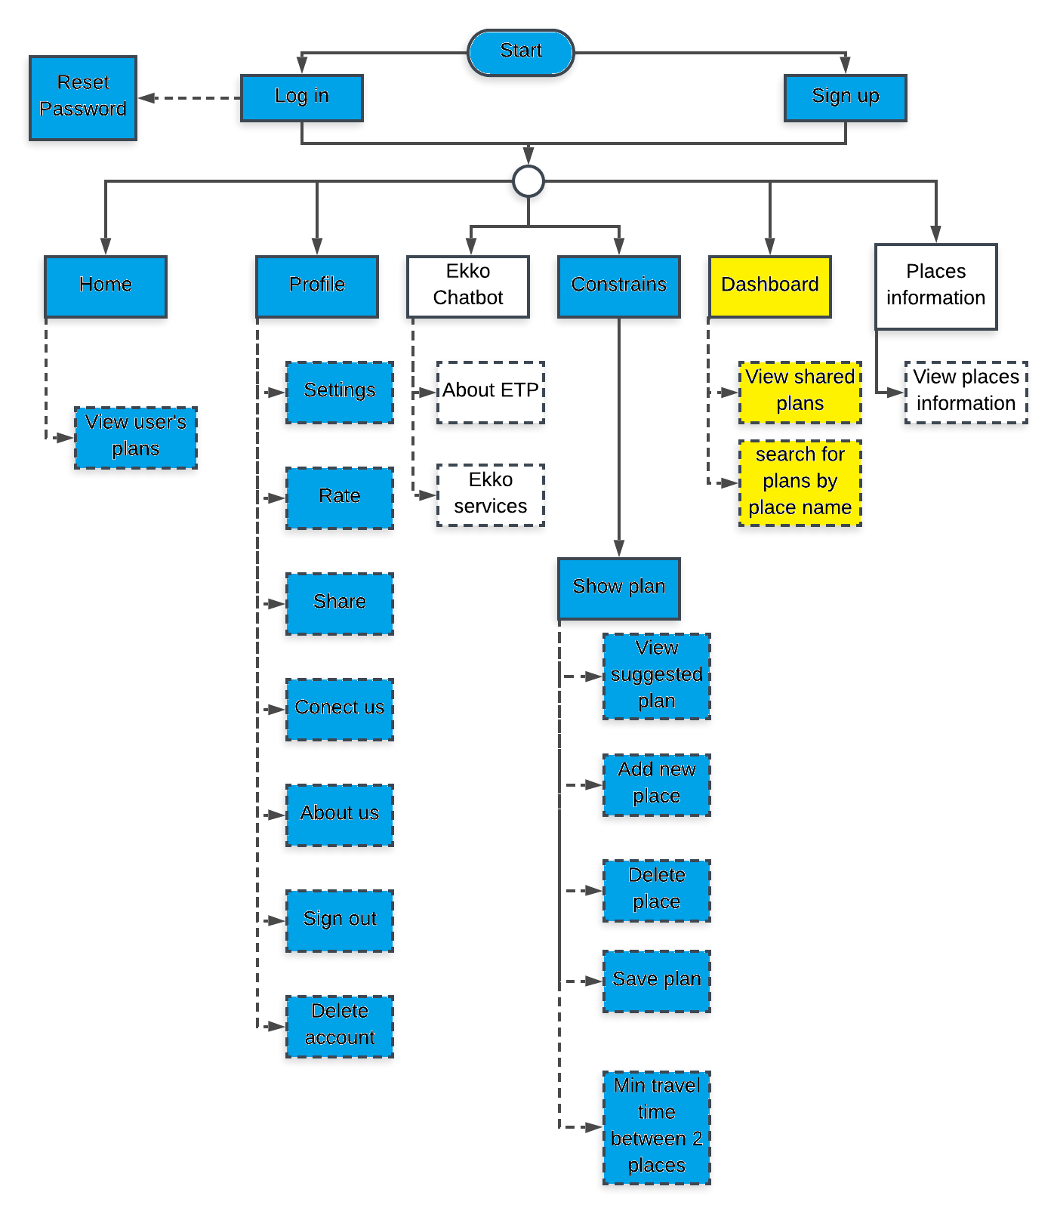
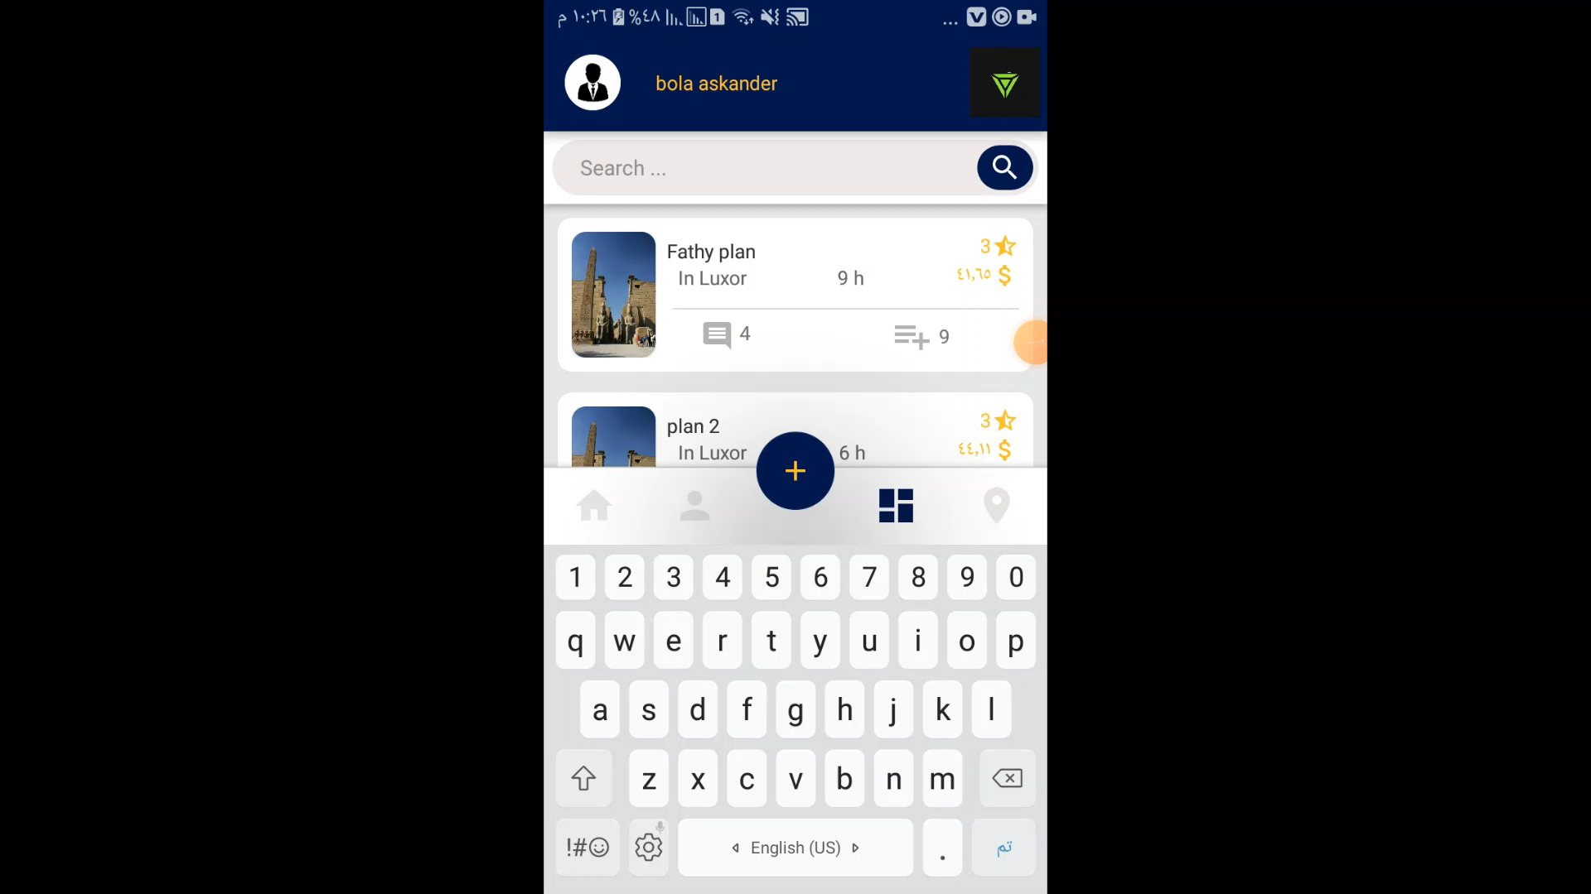
Dashboard

Slide 13
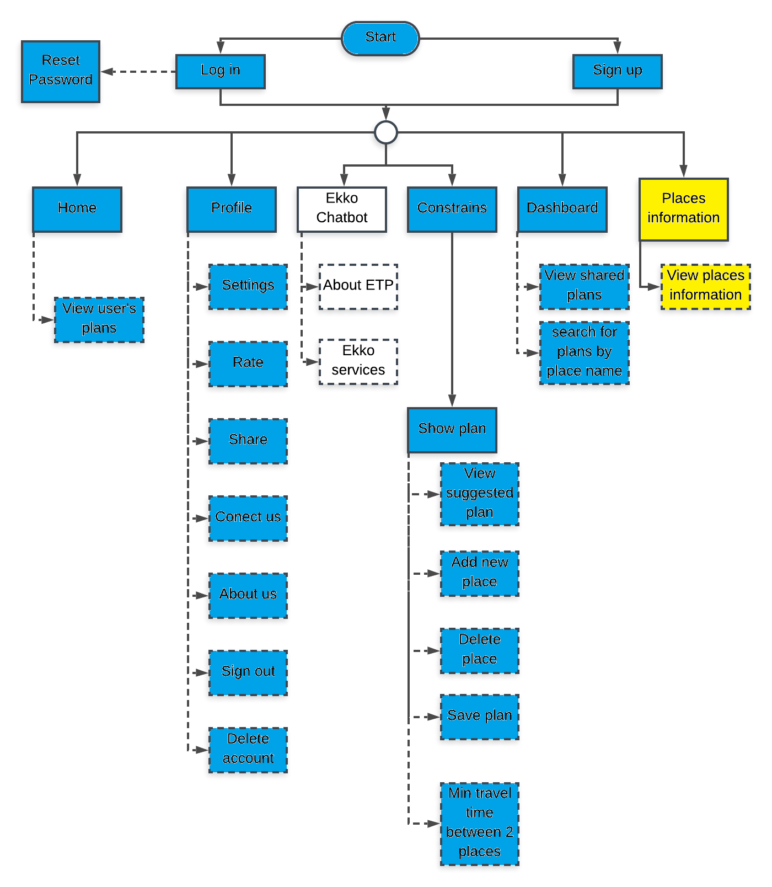
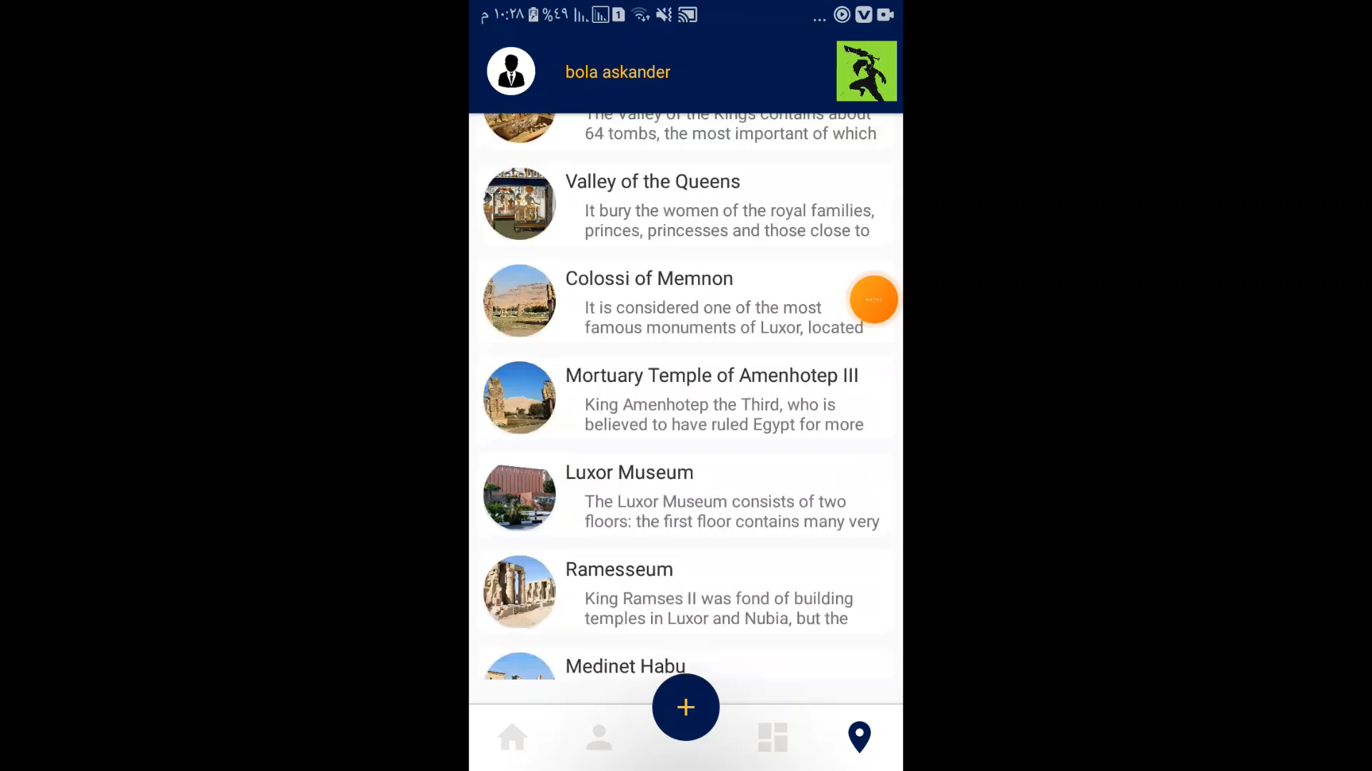
Places

Slide 14
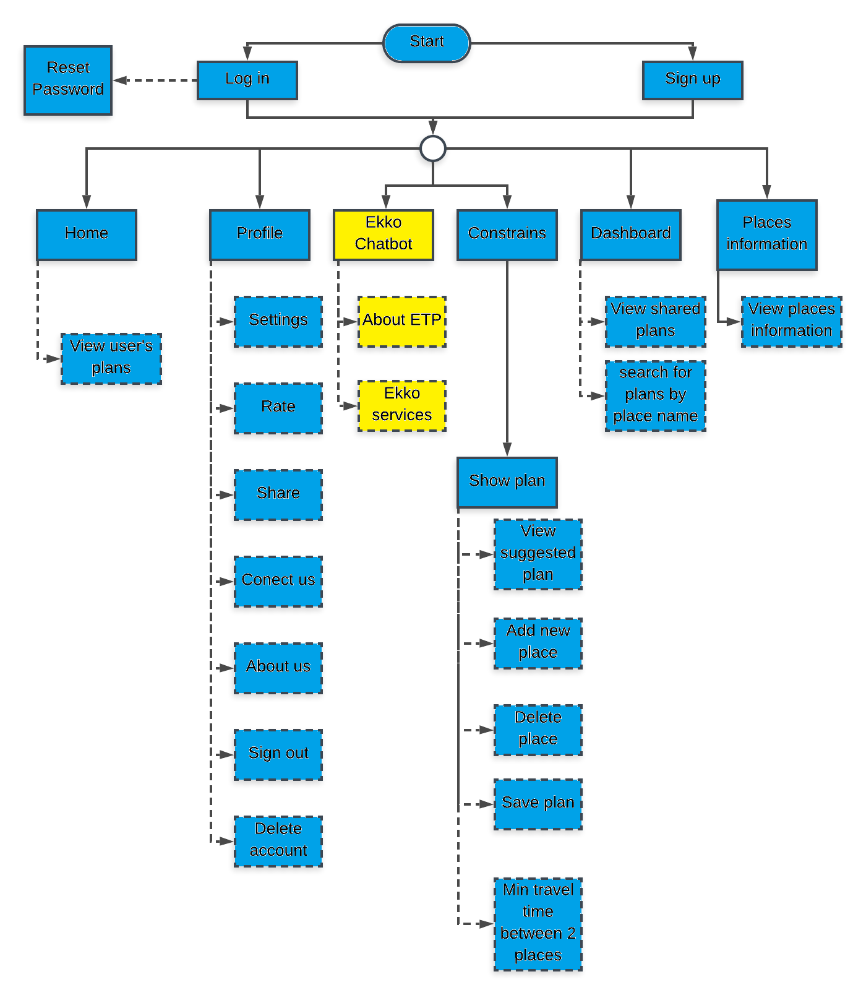
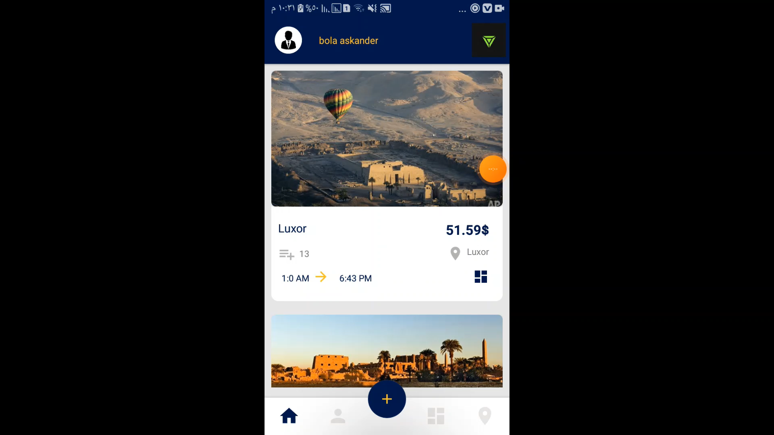
Ekko Chatbot

Slide 15
Algorithm overview
Data (User, Trip, Place) page 38 figure(25).
Constrains (Hard, Soft) page (40) figure(79)
POIs “Point of interests” (Morning, Night, Full/All time)
Plan (Morning plan, Night plan) page 42 figure (81)
Meta-heuristic tabu search algorithm

Slide 16
Algorithm Evaluation
Using 20 different places in the system, we made more than 70 tests for getting user’s plans.
The maximum time the algorithm needed to do his operation is 3 seconds.
There are many variables in the algorithm. So that we made many tests for most of these variables to test getting plan functionality in figures(53, 54, 55, 56, 57, 58, 59, 60).

Slide 17
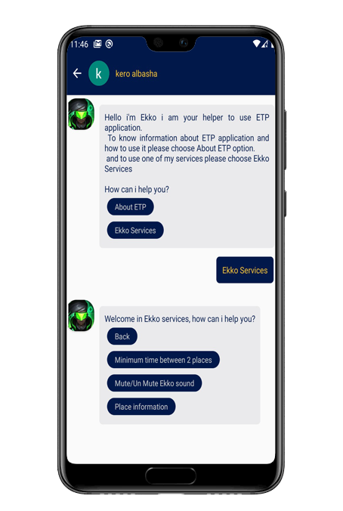
Ekko assistant:
Ekko is a static chat bot with fixed questions and answers and his main functionality is improving ETP usability by acting as customer service center,
and it shows that service by providing users with useful information to use
the application well.

Slide 18
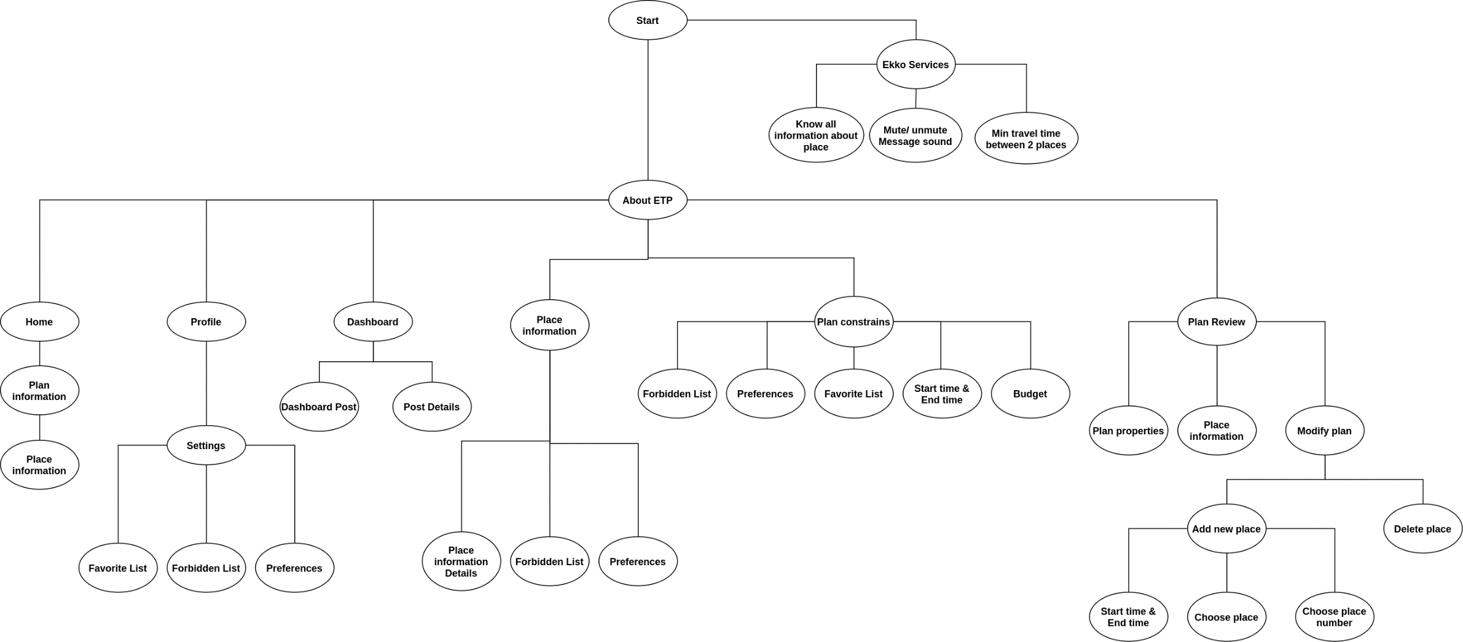

Slide 19
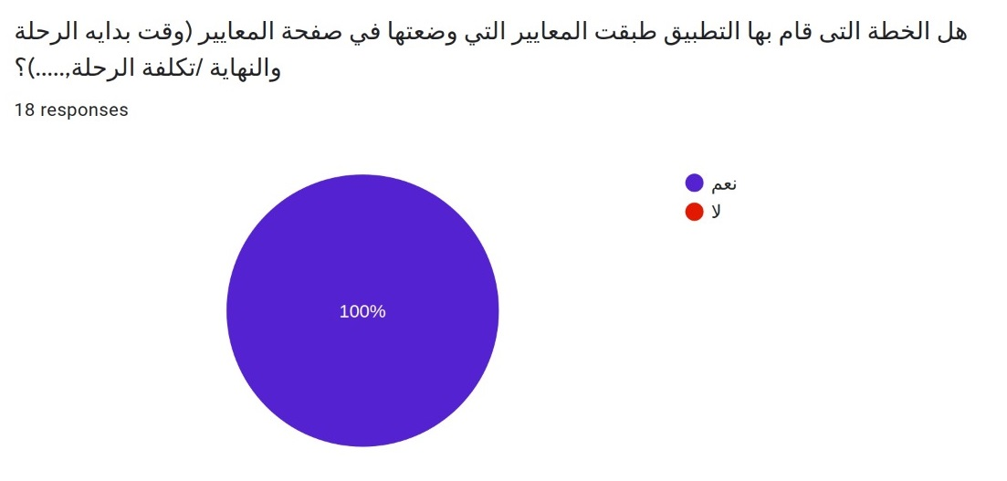
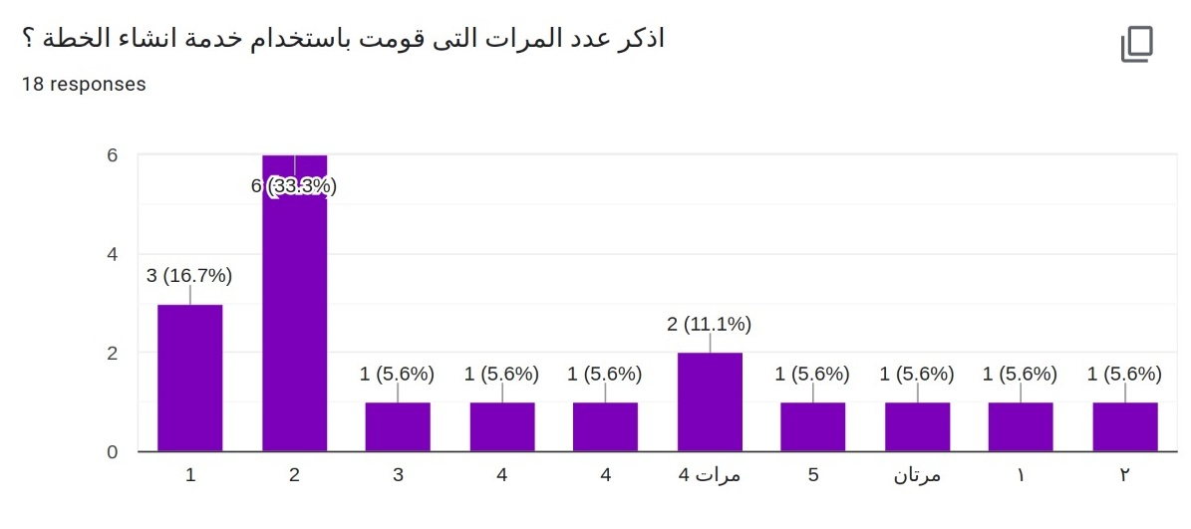
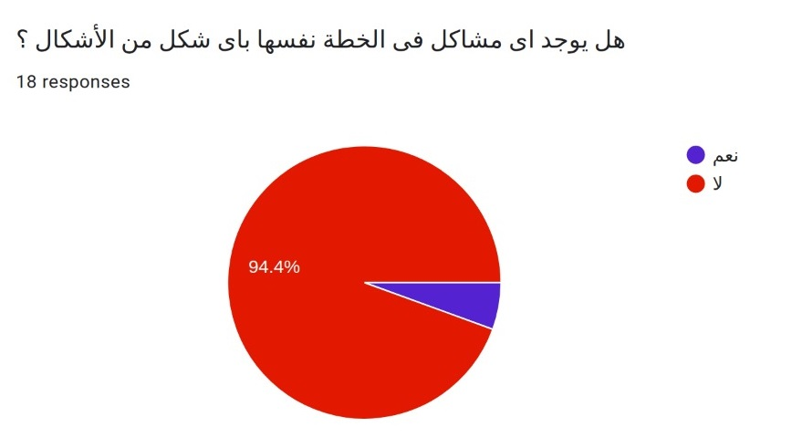
Feedback

Slide 20
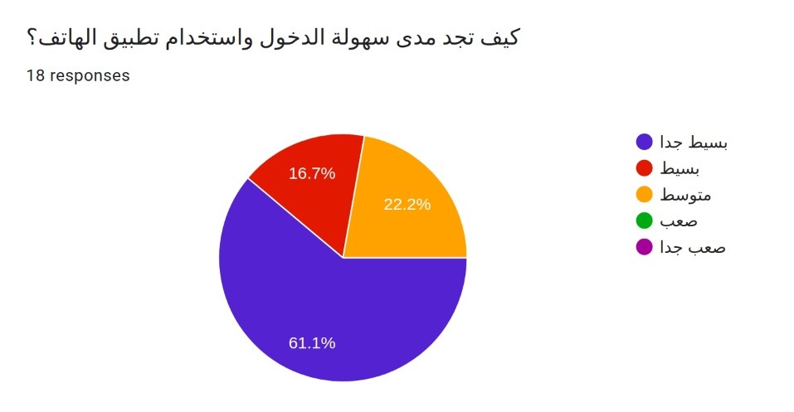
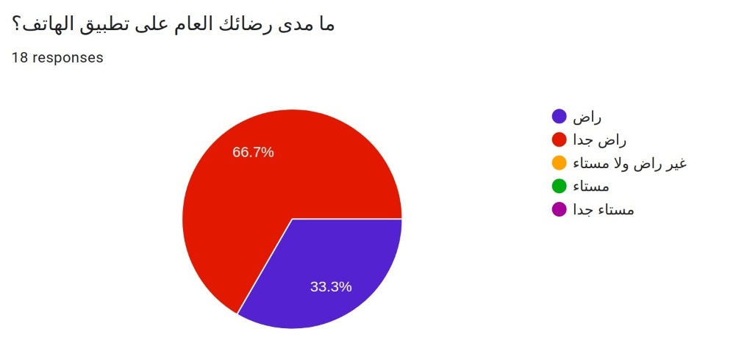
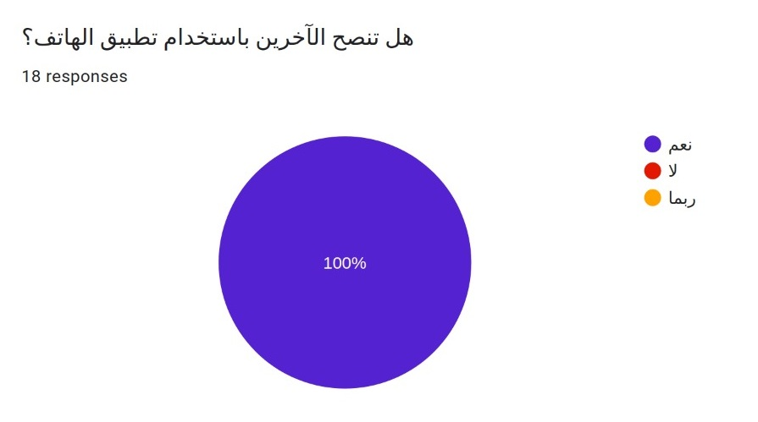
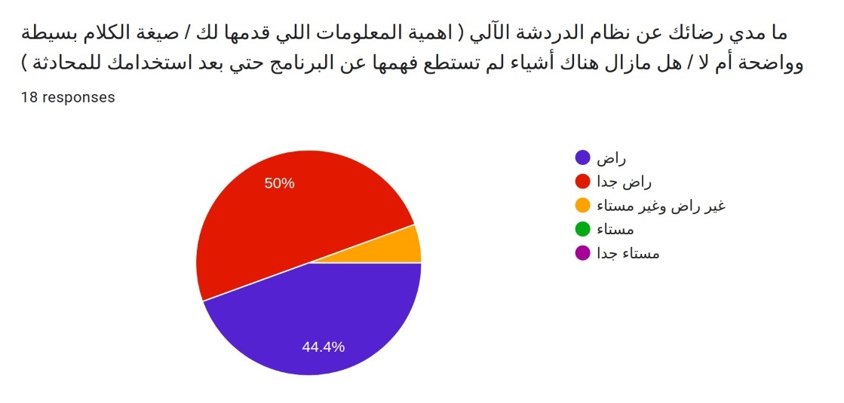

Slide 21
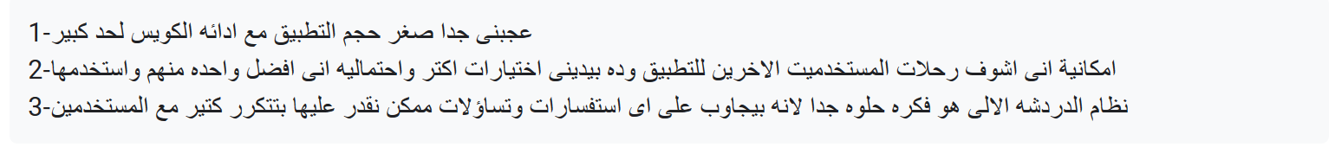
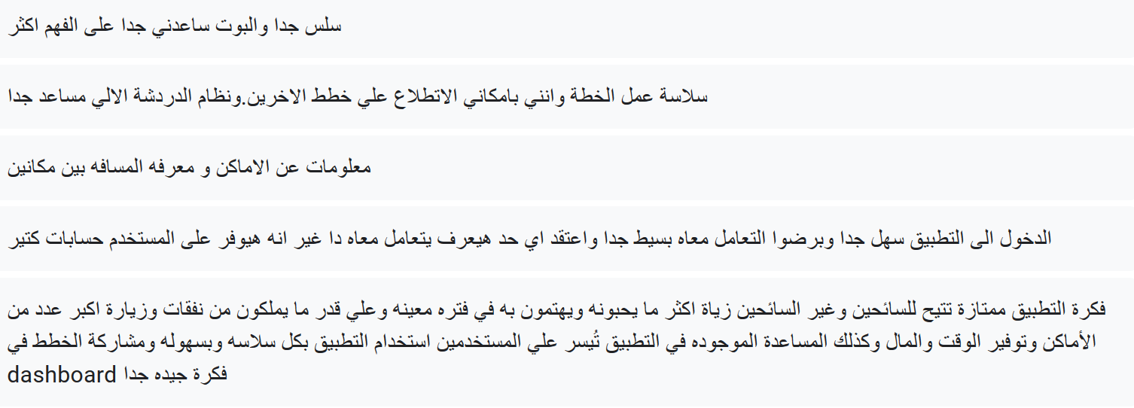
Feedback con.

Slide 22
Conclusion
ETP has made a strong effort to automate trip planning and provide a reliable service that collects all the information tourists need to prepare their trips.
Also, it provided many services to make the usage easier and achieve the best use of the application.
In fact, ETP successfully overcomes one of the main challenges for tourists by saving users time, money, and effort, and all these available in one Android app.

Slide 23
Thank You

